Slide 1
Monolithic vs. Microservice Architecture

Slide 2
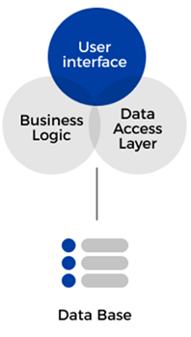
What is Monolithic Architecture?
A monolithic architecture is one where the entire application is built as a single, unified unit.
Characteristics
Single codebase
Single deployment unit (one WAR/JAR)
Shared database
Components are tightly coupled
An e-commerce application where:
User Management
Product Catalog
Order Processing
Payment
are all part of one Spring Boot application
A codebase is the complete collection of source code, configuration files, and documentation used to build and maintain a specific software application

Slide 3
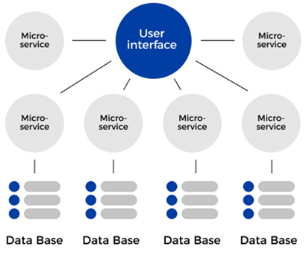
What is Microservice Architecture?
An application is divided into small, independent services, each responsible for a specific business capability
Characteristics
Each service is independently deployable
Loose coupling between services
Each service can have its own database
Communication via REST messaging
An e-commerce application where:
User Management
Product Catalog
Order Processing
Payment
Each service is a Spring Boot application

Slide 4
Comparison between Monolithic and Microservice Architecture
Feature | Monolithic | Microservices
Structure | Single application | Multiple small services
Deployment | One unit | Independent deployments
Scalability | Entire app | Individual services
Coupling | Tight | Loose
Technology | Single stack | Multiple stacks

Slide 5
Deployment - Monolithic Architecture: E-commerce Application
Process of releasing an application or service to a server so that users can access it.
Example Scenario
You fix a small bug in Payment module
You must:
Rebuild entire application
Redeploy the whole JAR
Restart the server
Problems
Downtime during redeployment
Risky (one change affects whole system)
Slower release cycles
Modules:
User
Product
Order
Payment
All modules are inside one application.
How Deployment Works
Entire application is built as one JAR/WAR
Deployed as a single unit – (ecommerce-app.jar)
(User + Product + Order + Payment)

Slide 6
Deployment - Microservice Architecture: E-commerce Application
Process of releasing an application or service to a server so that users can access it.
Example Scenario
Bug fix in Payment Service
Only payment-service.jar is redeployed
Other services continue running
Benefits
No system-wide downtime
Faster and safer releases
Continuous deployment possible
Modules:
User
Product
Order
Payment
Each service is independent
How Deployment Works
Each service has:
Its own codebase
Its own build
Its own deployment pipeline
user-service.jar, product-service.jar
order-service.jar, payment-service.jar

Slide 7
Scalability - Monolithic Architecture: E-commerce Application
Scalability is the ability of a system to handle increased load (users, requests, data) by adding resources without performance degradation.
Modules:
User
Product
Order
Payment
Suppose during a festival sale:
Product browsing traffic increases heavily
Order and Payment traffic remain normal
How Scaling Works
cannot scale Product module alone
must scale the entire application
Solution:
Deploy multiple instances of the same monolithic app
Use a load balancer
Problem
Wastes resources (scaling unused modules)
Higher cost
Performance bottlenecks remain

Slide 8
Load balancing - Example: E-commerce Application
A load balancer is a component that distributes incoming client requests across multiple server or service instances so that no single instance is overloaded.
Scenario
During a festival sale:
Thousands of users browse products
You run 3 instances of Product Service
User Requests
|
Load Balancer
/ | \
PS-1 PS-2 PS-3
What the Load Balancer Does
Receives all incoming requests
Forwards each request to a healthy instance
Ensures no instance is overloaded

Slide 9
Scalability - Microservice Architecture: E-commerce Application
Same Example Split into Services
User Service
Product Service
Order Service
Payment Service
Festival Sale Scenario
Product Service gets 10× traffic
Other services get normal traffic
How Scaling Works
Scale only Product Service
Deploy more instances of Product Service
No need to scale Order or Payment services
Benefit
Efficient resource usage
Lower cost
Better performance

Slide 10
Coupling - Monolithic Architecture: E-commerce Application
Coupling refers to how strongly one component/service depends on another.
Tight coupling → strong dependency
Loose coupling → minimal dependency
2. Shared database
All modules access the same tables
A schema change affects every module
3. Single deployment
Changing Payment module → redeploy entire application
Result
Order module cannot work independently
Any change in one module affects others
Tight Coupling (Monolithic Architecture)
Modules:
User Management
Product Catalog
Order Processing
Payment
All are inside one application.
How Tight Coupling Happens
1. Direct method calls
OrderService orderService = new OrderService();
orderService.createOrder();

Slide 11
Coupling - Microservice Architecture: E-commerce Application
2. Independent Databases
Order Service → Order DB
Payment Service → Payment DB
Schema changes in Payment DB do not affect Order Service.
3. Independent Deployment
Update Payment Service
Order Service continues running unchanged
Result
Services are independent
Failure in Payment Service does not crash Order Service
Easy scaling and maintenance
Loose Coupling (Microservices Architecture)
Same Example Split into Services
User Service
Product Service
Order Service
Payment Service
Each is a separate application.
How Loose Coupling is Achieved
1. Communication via APIs
Order Service talks to Payment Service using REST:
POST /payment/process
No direct access to internal code.

